Slide 1

Transition to Nursery
Grove Lea Primary
“If it is to be, it is up to me!”

Slide 2
This meeting will hopefully provide you with an insight into our Nursery and the opportunities and experiences that your child can look forward to. We are all extremely proud of our school and committed to providing the very best possible education for all of our children. We know that Grove Lea Primary is a school where:
School Rights
To keep ourselves and others Safe
To be Respectful
To come to school and Learn
Core Values- Also known as the 4C’s
Courageous
Curious
Caring
Collaborative
Notes:
2

Slide 3
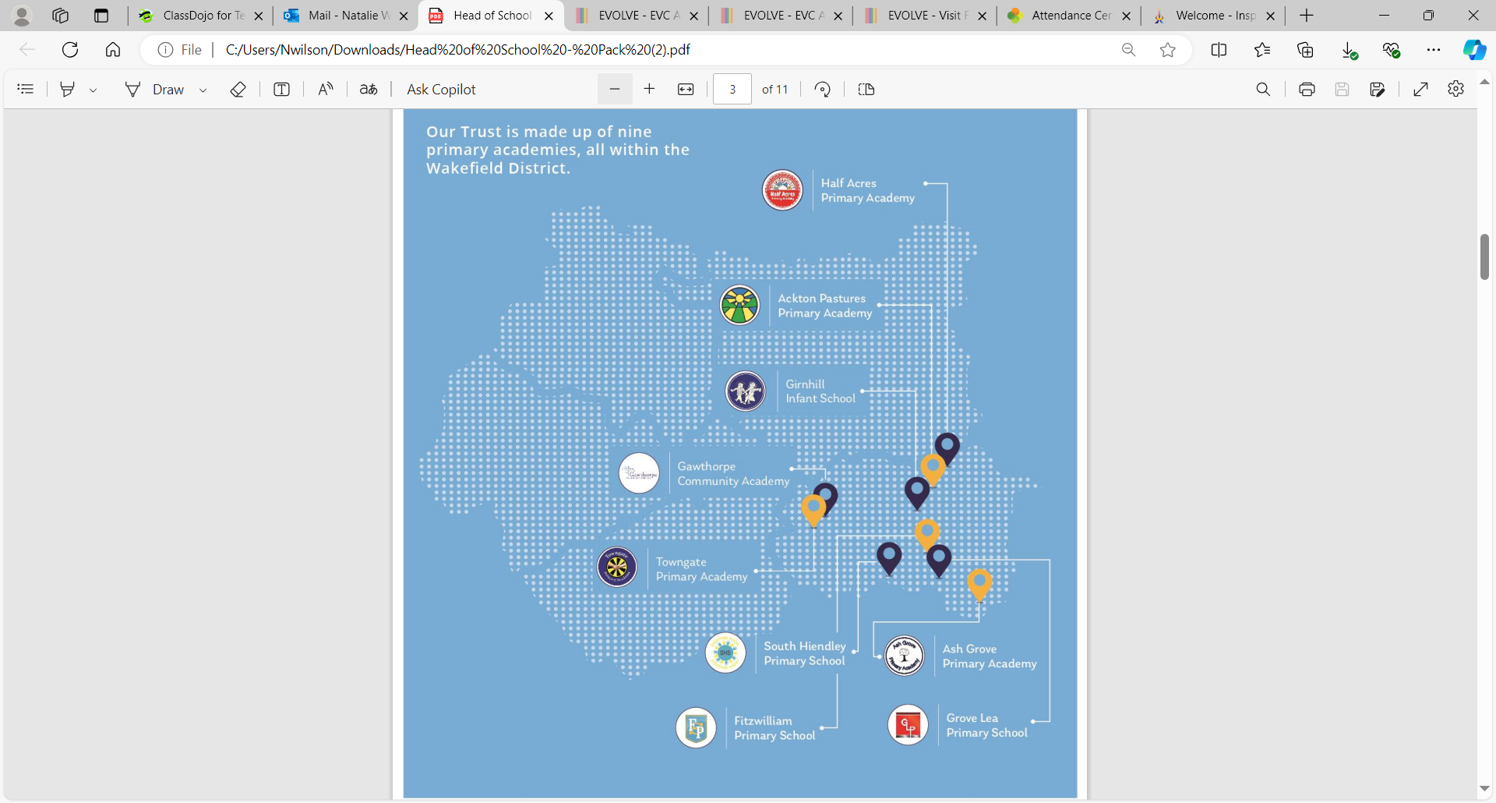

Slide 4
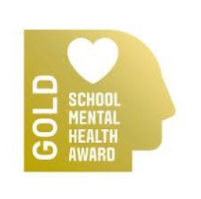
Mental Health and Well-being
At Grove Lea Primary provide the children with a mental health and wellbeing curriculum. This has been delivered through themed sessions each half term.
We as a school value the importance of MHWB in order to ensure that children have the best possible chances they need to be safe and happy.
Please follow the link below, which outlines how we embed Mental Health and Well Being throughout the curriculum, as well as the additional support we will offer for any children who may need it.
Mental Health & Wellbeing - Primary School –
Grove Lea Primary School (ipmat.co.uk)

Slide 5
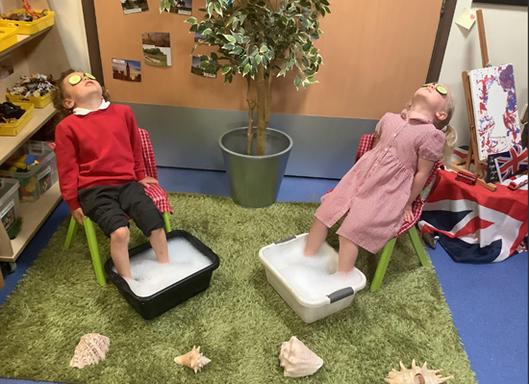

Slide 6



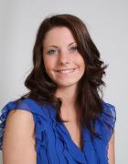
Meet the Team
Mrs Henshall
Executive Headteacher
(Safeguarding Lead)
Mrs Wilson
Head of School
Miss Litchfield
Learning Mentor
Mrs Dransfield
Special Needs Coordinator

Slide 7


Meet the Team
Miss Liversidge
Teaching Assistant
Mrs Burton
Nursery Teacher
Mrs Fletcher
Nursery Nurse
Mrs Wilson
Foundation Stage Leader, Nursery Teacher

Slide 8
The Curriculum
We follow the Early Years Foundation Stage Curriculum
This curriculum is delivered through play with each child’s interests and needs being at the centre of all our planning. Activities change weekly to support children’s learning around the theme of that week.
The staff will spend time observing your child to find out their needs and interests
Notes:
8

Slide 9
Child Initiated Play
For most of the session children choose from the different learning areas inside and outside.
They can access resources freely which allows them to follow their own interests, build their skills in problem solving and develop their ideas at their own pace.

Slide 10


The adults role
During a session the adults’ main role is to observe and support children in play.
This helps us to extend their learning, to gain ideas to include in future planning and provides opportunities for us to assess understanding.
Notes:
Parents will be asked to fill out a questionnaire about their childs interests to help us with a starting point. We value contributions from parents about what their child achieves at home.

Slide 11
We encourage independence
We encourage children to:
- take off and put on their own coat
- change their own shoes
- use the toilet and washing hands independently
- become more independent in play,
taking turns and asking for and sharing toys
In your packs you will find a readiness checklist to support your child in preparing for coming to Nursery.

Slide 12
Floorbooks
Each area of learning has a floor book to record WOW moments in learning throughout the Nursery year
Photographs will be regularly taken and added along with annotations across all aspects of learning in the class floorbooks.
Notes:
12

Slide 13

Learning in the Early Years

Slide 14
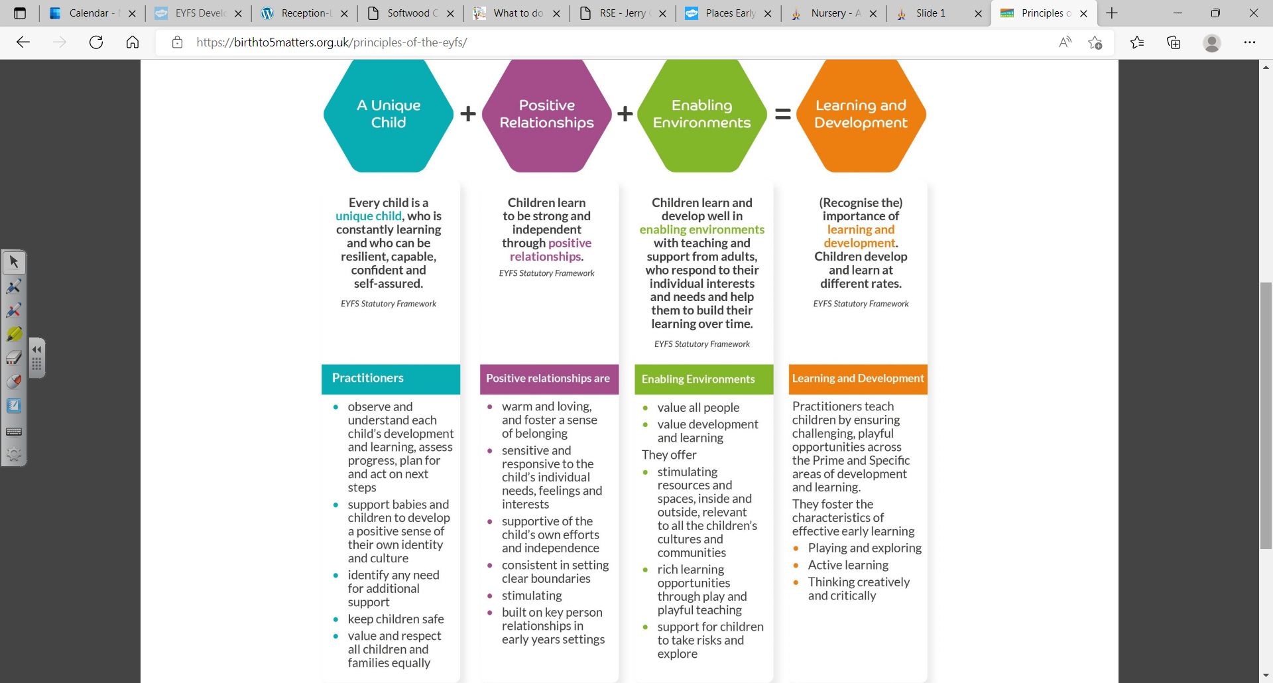

Slide 15
Your child will be learning skills, acquiring new knowledge and demonstrating their understanding through 7 areas of learning and development.
3 Prime areas-Communication and language, Physical development and Personal, social and emotional development.
As children grow, the prime areas will help them to develop skills in 4 specific areas. These are:
Literacy, Mathematics, Understanding the world and Expressive arts and design.
Over the next few slides you will see what this looks like in the Nursery setting.

Slide 16
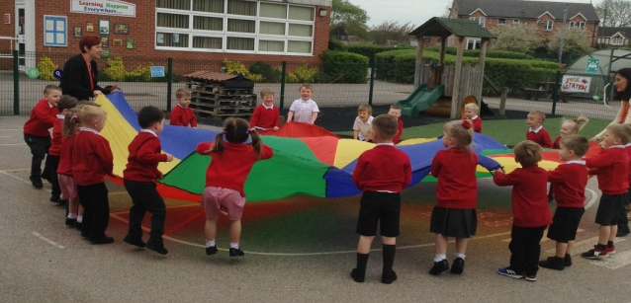
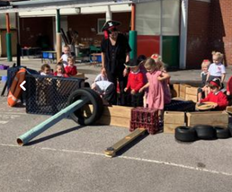
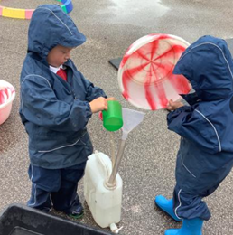
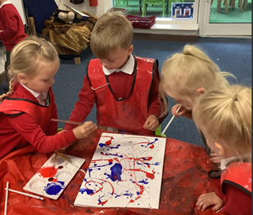
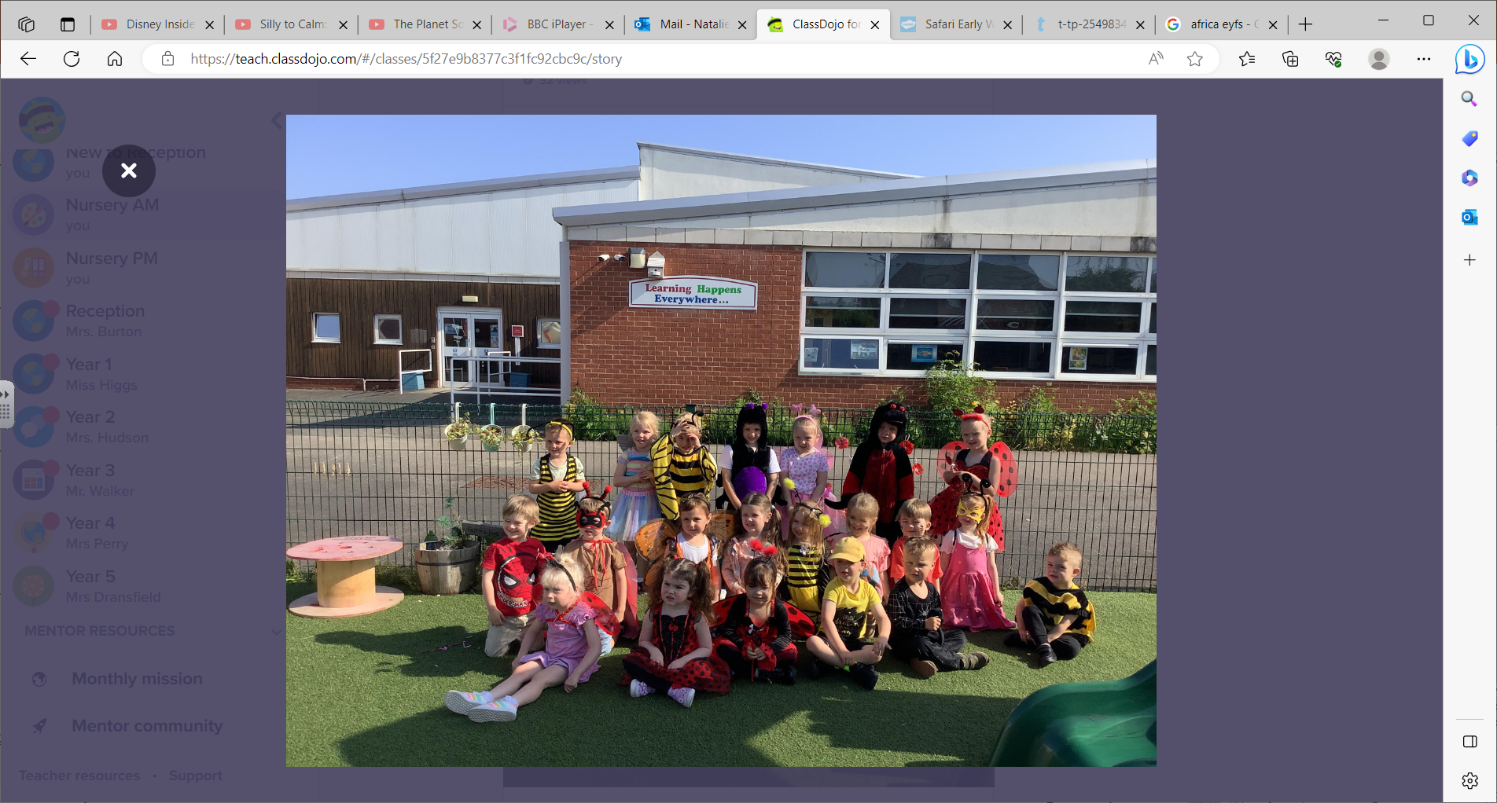
Personal, Social,
Emotional Development
Self Regulation
Managing
self
Managing
Feelings
Building
Relationships

Slide 17
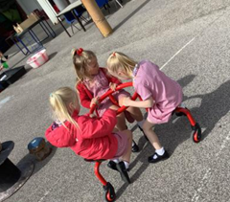
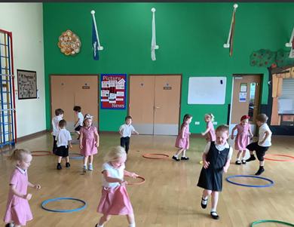
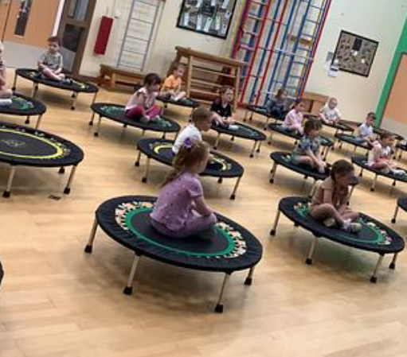
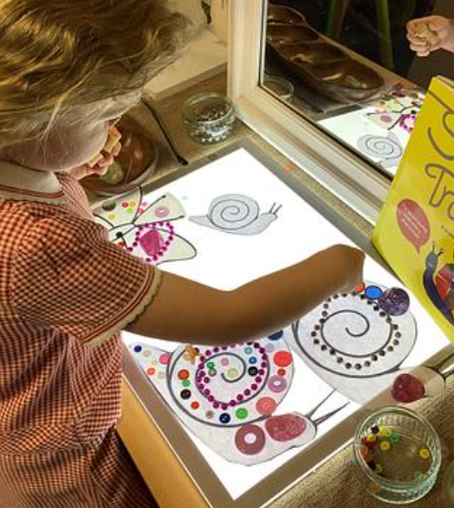
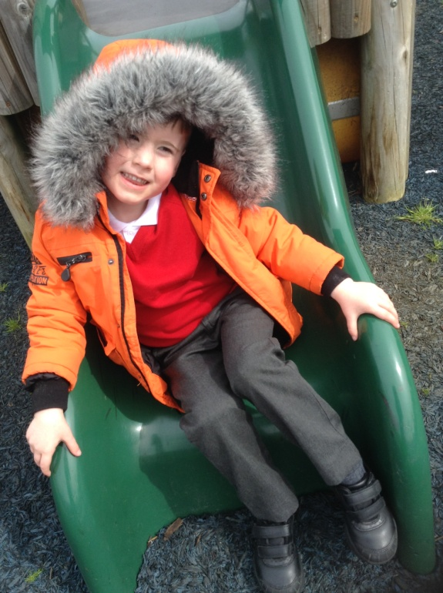
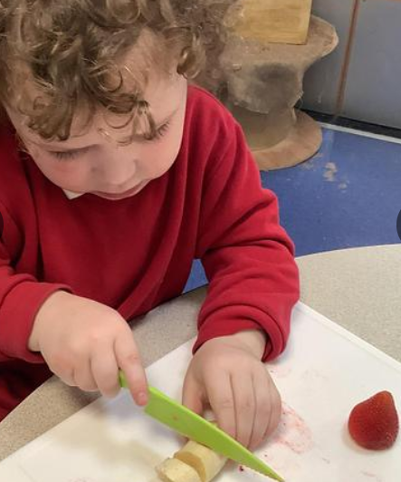
Physical
Development
Fine Motor
Gross Motor

Slide 18
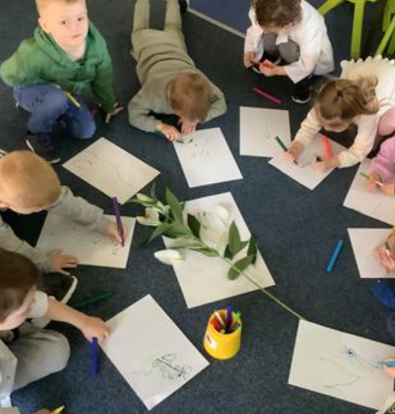
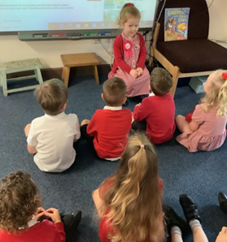
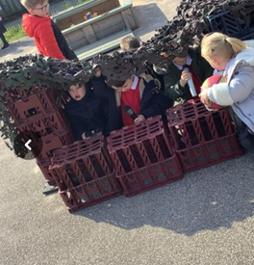
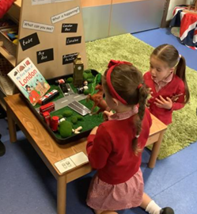
Communication
and Language
Speaking
Listening and Attention
Listening, attention and Understanding

Slide 19
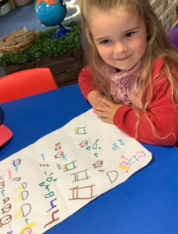
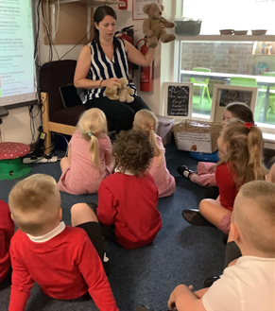
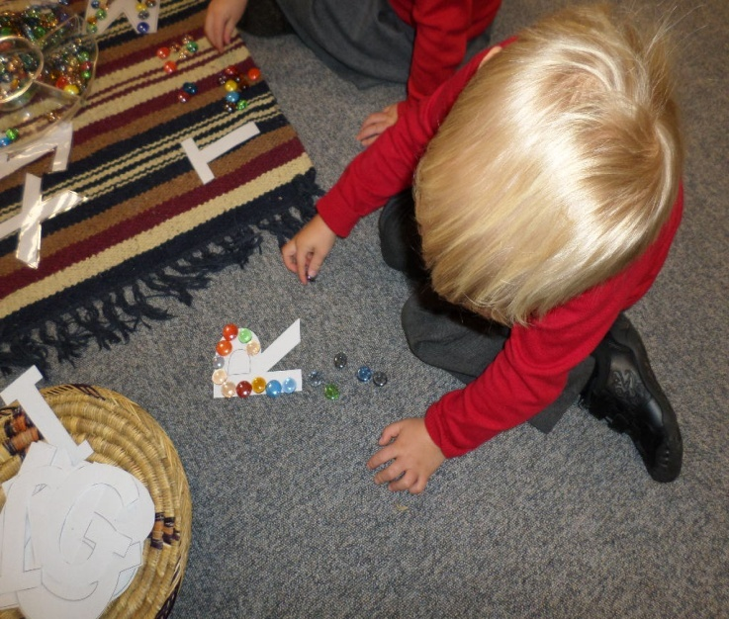
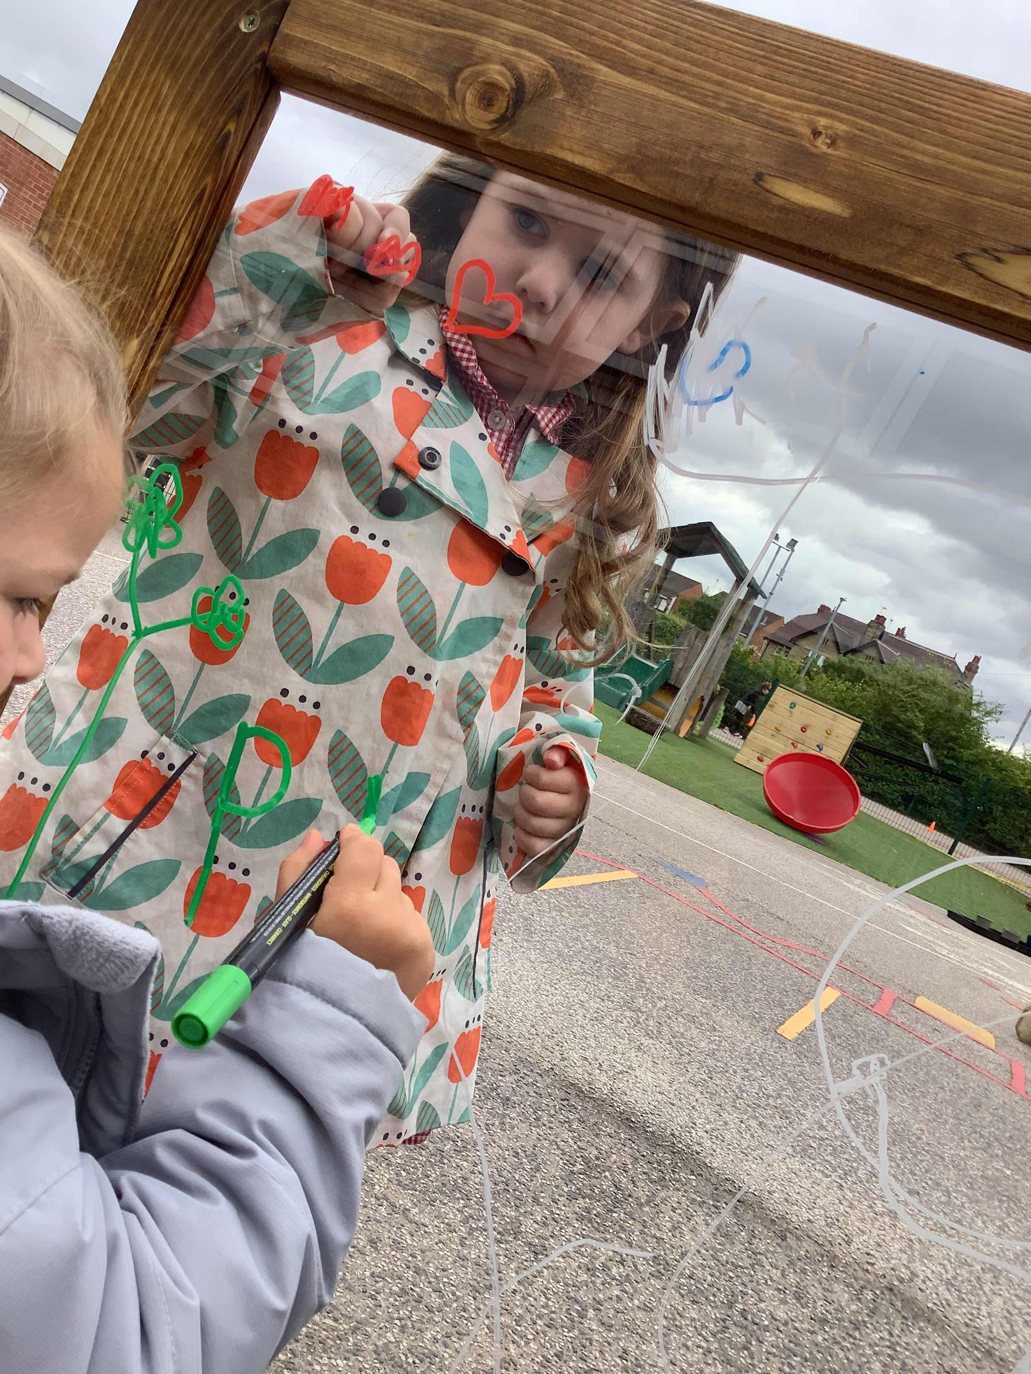
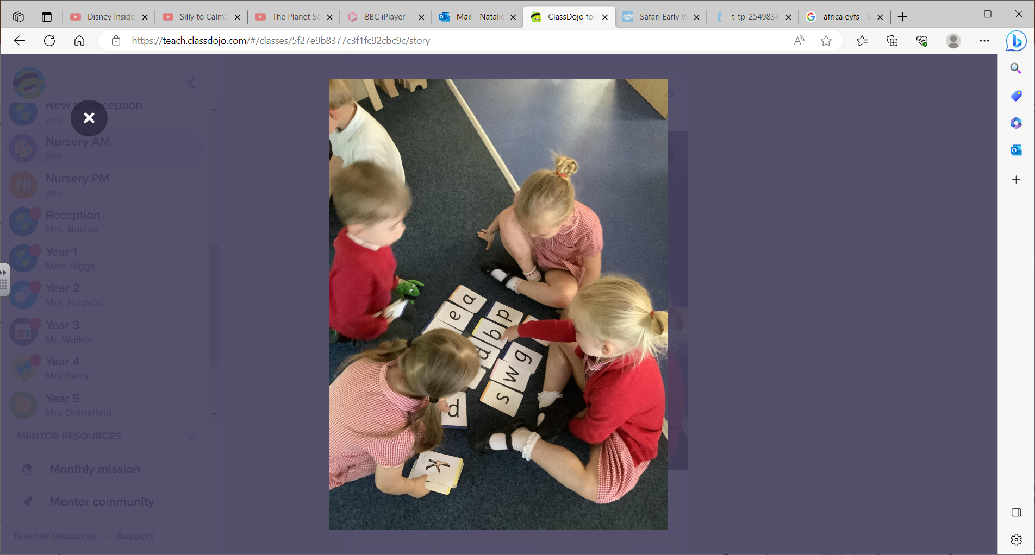
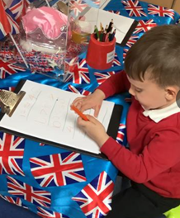
Literacy
Writing
Reading
Writing
Comprehension Word reading
Notes:
Use of phonics
19

Slide 20
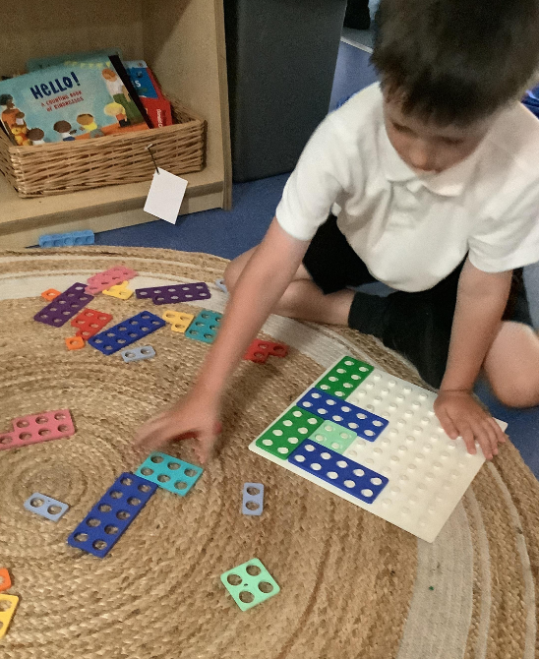
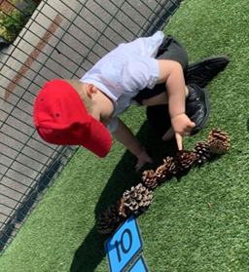
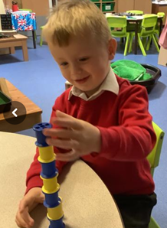
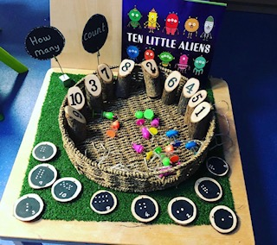
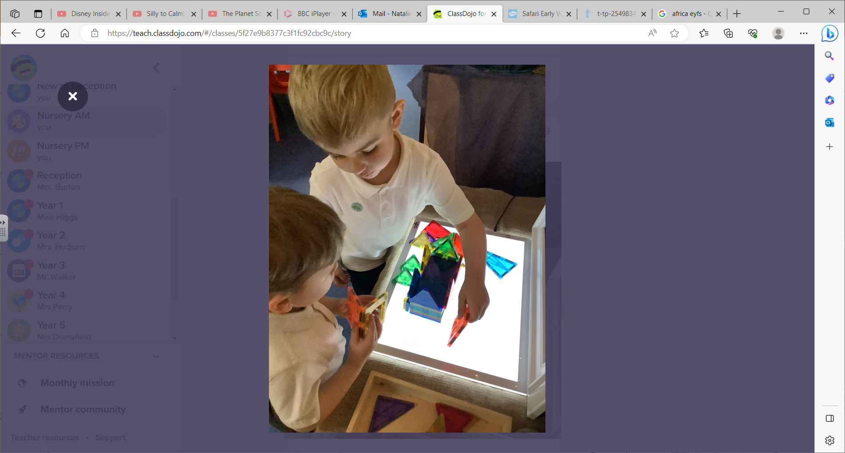
Mathematics
Number
Number
Numerical patterns

Slide 21
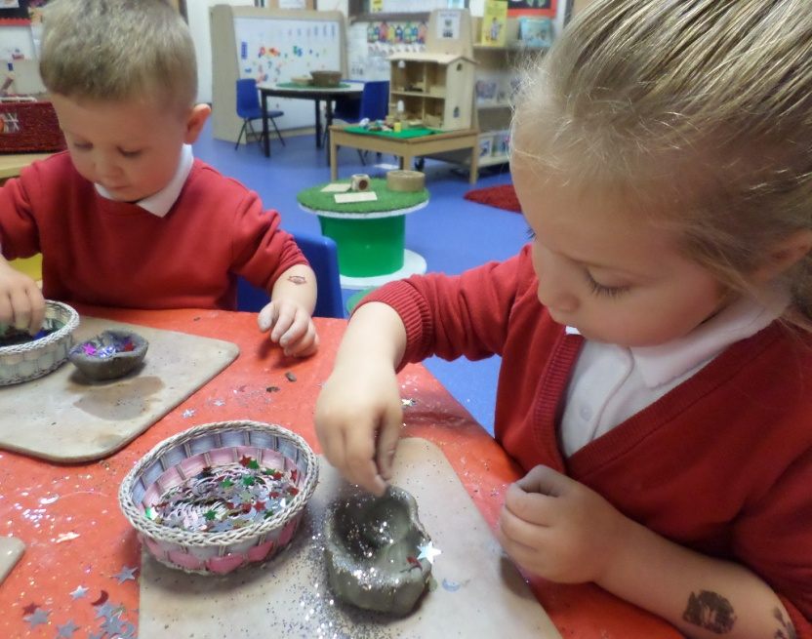
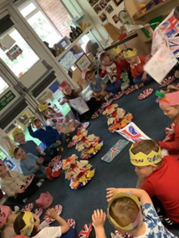
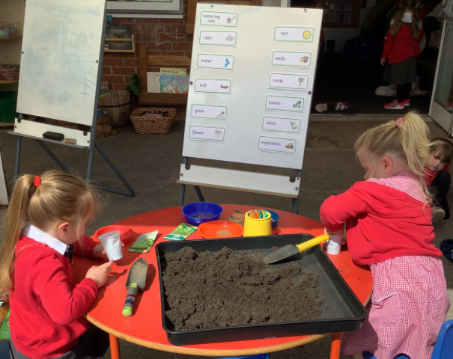
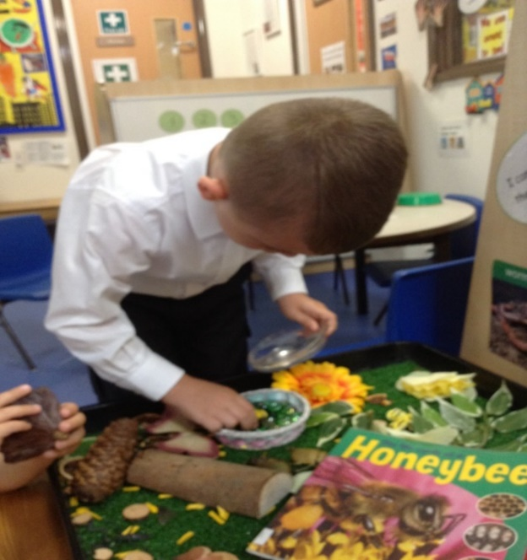
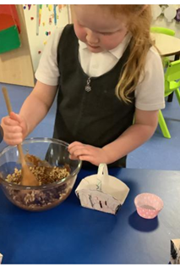
Understanding
the World
People,
Culture and Communities
Past and Present
The Natural World

Slide 22
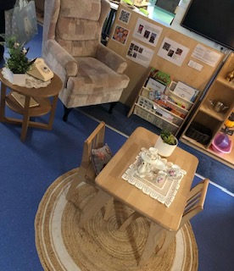
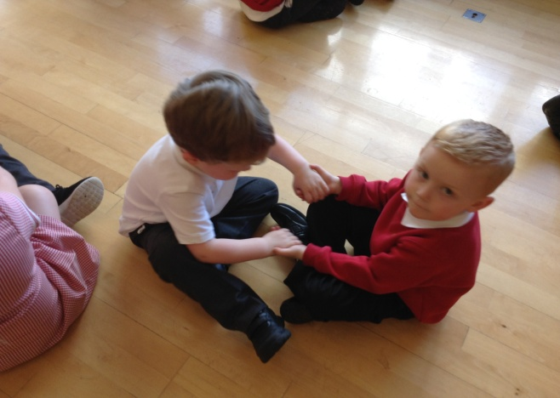
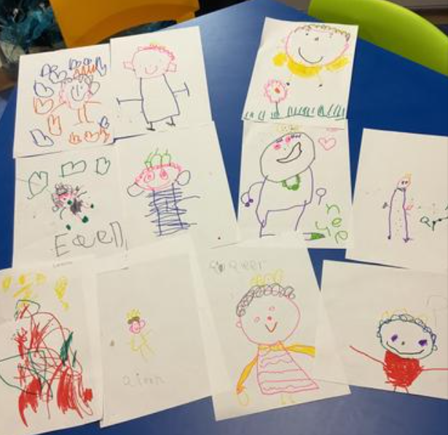
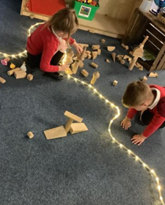
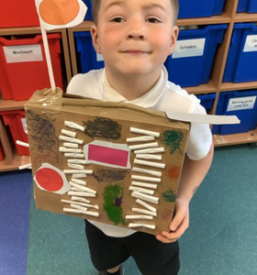
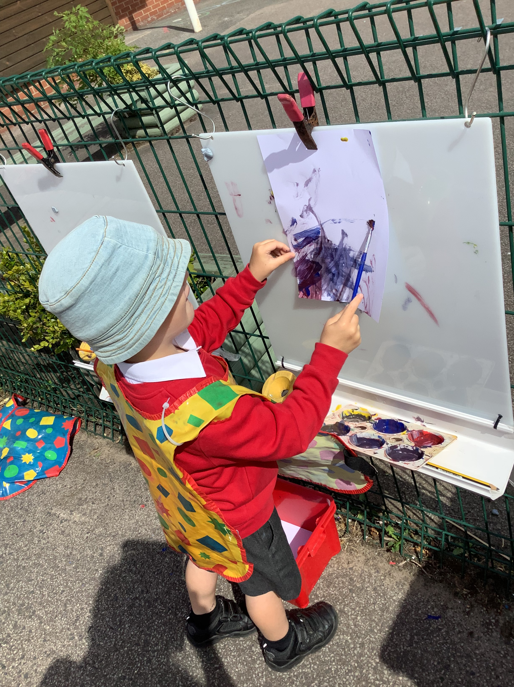
Expressive Arts and Design
Being Imaginative and expressive
Creating with materials

Slide 23
Ready to start Nursery
52 place Nursery and 30 place Reception class
Nursery sessions are 8.30am – 11.30am / 12.30pm -3.30pm (30hrs children 8.30-3.30)
Children come into Nursery and move on to self- initiated activities. Drop off at the door / end of day children will be called sent to you in the playground.
Collection Arrangement
We appreciate if you could drop off and pick up as promptly as possible-Anyone arriving late will need to enter through the main office.
We take the security of the children very seriously.
At the end of the session we will only allow your child to be collected by people that you have authorised to do so
(password)
Please make sure we are notified of any changes
Notes:
23

Slide 24
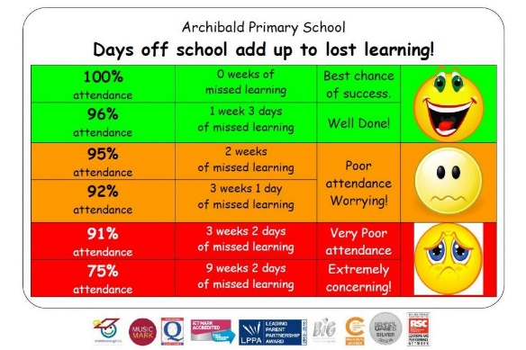
Attendance
It is important that children attend each Nursery session to avoid lost learning.
Holidays are not authorised during term time. Fines can be given to children once they reach the age of 5.
It is really important that you contact us using the school number (01977 615080) if your child is unable to attend a session. Please ring before the session starts. If we do not hear from you a member of the team will contact you to ask for a reason for absence.
If your child has sickness/diarrhea-48hrs before they can return after their last bout of illness
Notes:
24

Slide 25
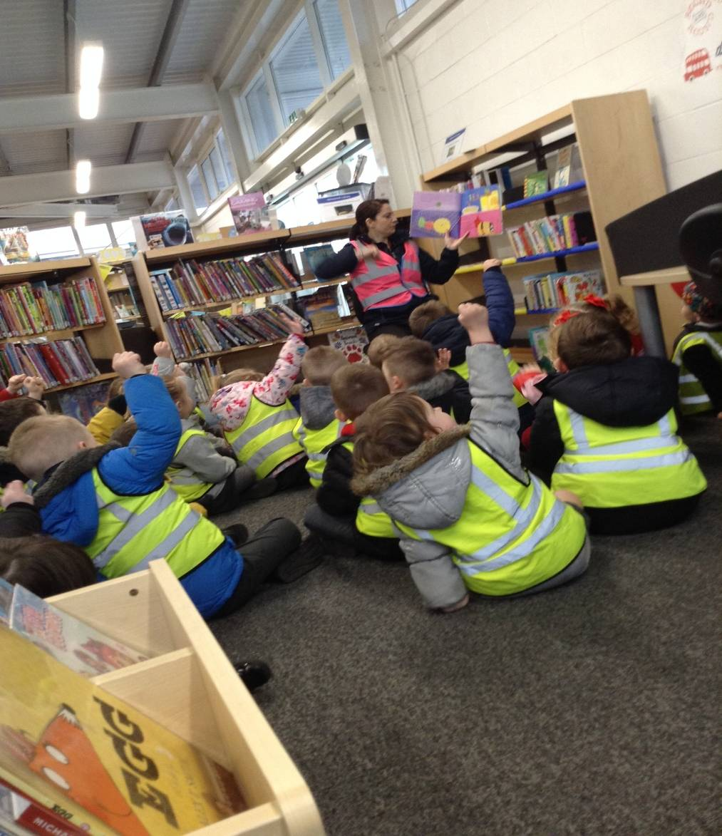
Library Day
We visit the local library and share a story. We would love it if you could join us. You will be notified in advance before library visits. We aim for once every half term.

Slide 26
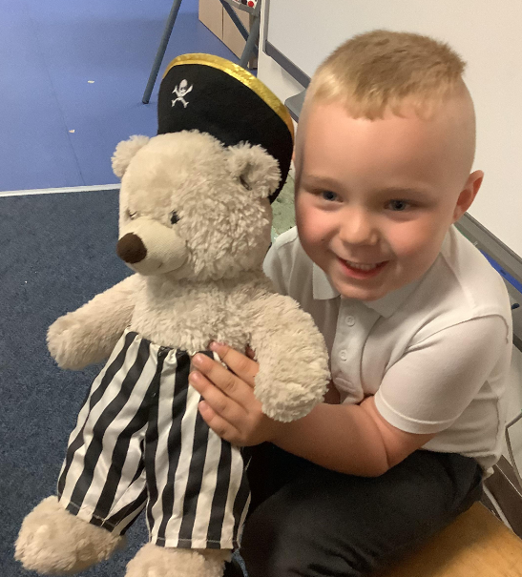
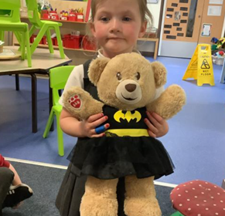
Weekend Bears

Slide 27
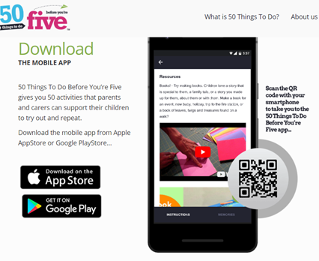

50 things to do before you’re 5!
The 50 Things To Do Before You’re Five mobile app gives parents and carers 50 low or no-cost experiences to support their child's social, emotional, physical and early language development.
The app contains all the information, guidance and supporting resources to allow parents to build a memory bank of photos and videos, as a collection of their child's special moments.

Slide 28
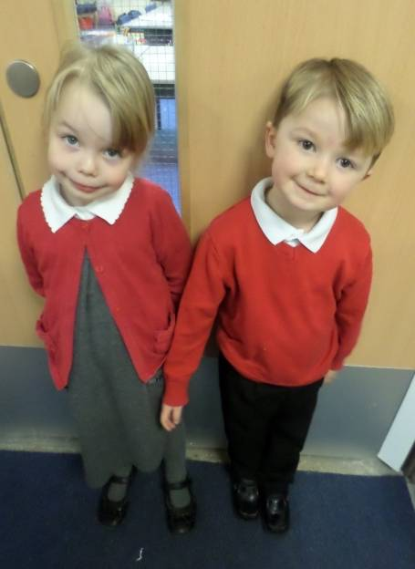
School Uniform
School uniform (see pack for details)
Please label all items of clothing (even shoes)
Our logo is available through Tesco Uniform
(myclothing.com).
Clothing
Plain grey or black school skirt or trousers.
Red and white checked dress or plain grey or black knee length tailored shorts in summer.
White school blouse or polo shirt.
Berry red cardigan or sweatshirt.
White, black, red or grey socks/tights.
Headbands, slides & bobbles in school colours (red/white/grey/black)
Plain black shoes or black trainers with no logos. No flashing lights please. If children come to school in boots or wellingtons, they will need to bring their shoes to change in to.
Velcro shoes are easier to support independence as the children change into wellies for the outdoor / sand area at times.
We do ask for a spare bag of clothes to be brought daily to the session. Just in case. We do also ask children to bring a pair of wellington boots with their name in to leave at school, as we do access the outdoor environment in all weather (we provide puddle suits). Jewellery is not permitted other than watches and one pair of small gold or silver stud ear-rings.
Notes:
28

Slide 29
Contact numbers and emergencies
Please inform us of any changes to information especially phone numbers. We also require at least 2 emergency contact numbers please.
Notes:
29

Slide 30
Medical Needs
Dietary/Medical Requirements:
Please ensure we are informed of
any special dietary requirements, food
allergies or medical needs
Inhalers-
If your child requires an inhaler we do need an inhaler that we can keep at school at all times, should they require it.
Notes:
30

Slide 31
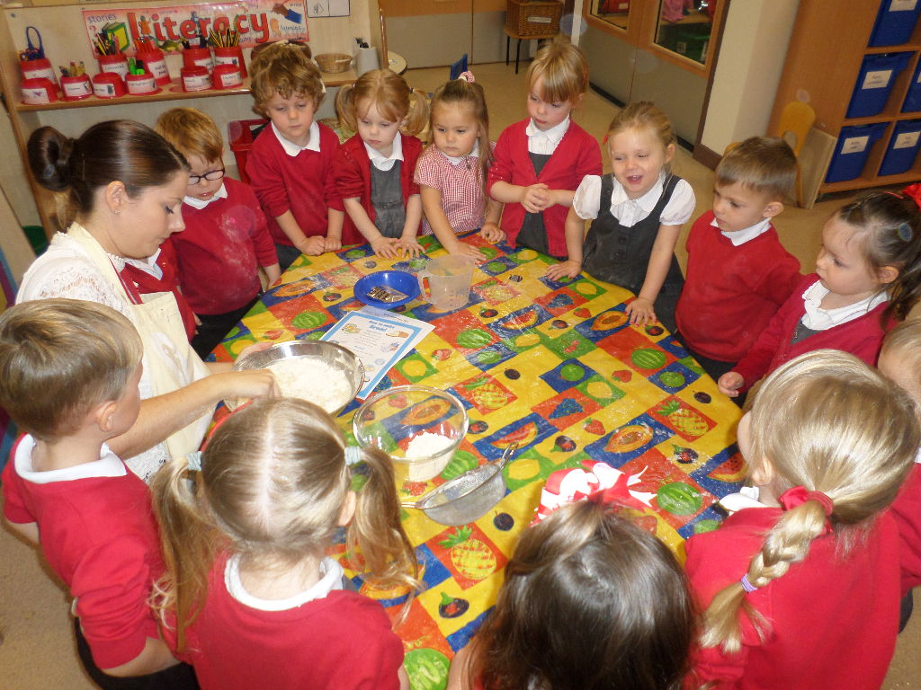
The Snack Bar
50p each week
for
Snack
Collected on a
Monday
We support, encourage and observe children’s independence within this area.
Your child is entitled to a free carton of milk each day. We do also ask for children to bring in a water bottle (with water in please, as we are a healthy school) each day labelled with their name.
Notes:
31

Slide 32
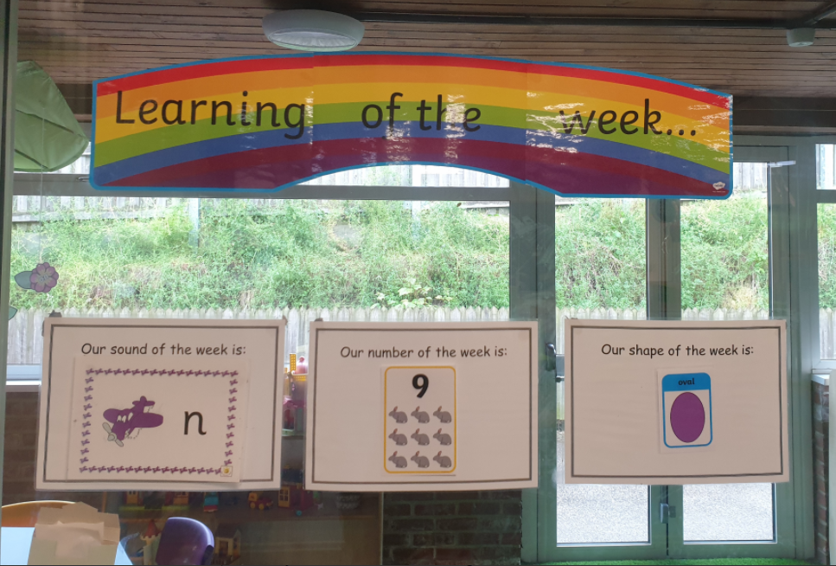
Parental involvement.
Our aim at Nursery is to work in partnership with you. We have a variety of ways in Nursery that we can do this.
Library visits and taking books / activities to share at home
Coming into Nursery to take part in themed days
Learning of the week activities
Busy bags / story and number rhyme sack lending service
Learning of the week
Notes:
32

Slide 33
How to help…
Playing games that involve taking turns.
Playing with children who are of similar age to develop social skills.
Playing with Alphabet letters.
Playing with cut out numbers so the child has an awareness of these.
Using your child's favourite toys to role-play going to school.
Painting and drawing, which involve sitting down for short periods of time.
Constantly talking to your child and listening to their answers will is a really important activity and builds language skills and social skills.

Slide 34
Sing Nursery Rhymes and songs that children like that have repetition in them as these will help them to remember new words.
Telling or reading stories and poems to your child is an important part of developing an interest in reading. This should be an enjoyable experience for yourself and your child. You should aim to do this for a short period (e.g. 10 minutes at least) every day. When reading a story, encourage your child to talk about the pictures and identify characters.
Let your child hold the book and turn the pages as you read the story.
Children often ask for the same story over and over again. This should be encouraged, as it shows an interest in reading, and will assist in developing the language of writing, value your child’s choice and encourages decision making.

Slide 35


Slide 36
Please check dojo for messages and updates
Start dates have been messaged to you on the dojo app

Slide 37

Other things to mention…
Class Dojo
X
@IPMATGroveLea
Supporting behaviour through a star of the week, stickers, Friday treat. We encourage the children to make the right choice and use lots of praise and positive strategies
School website
grovelea.ipmat.co.uk

